Slide 1
FIT & HOT
Body Fat Estimator APP
By Oktay Sadak

Slide 2
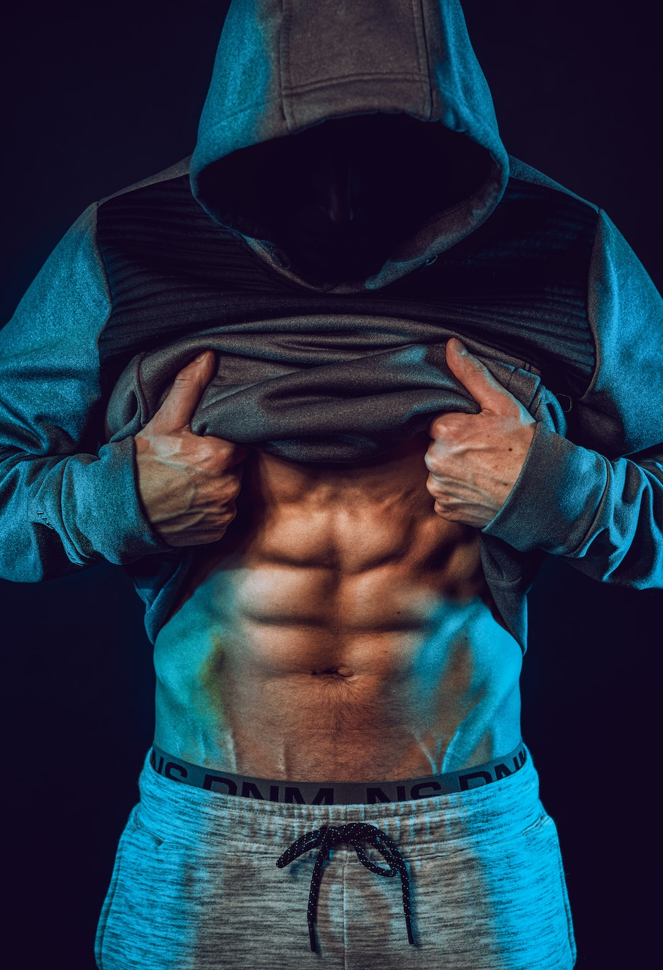
Agenda
Introduction
Why is body fat important?
The problem
Dataset
The solution
Features
Your own body measurements
How does it work?
Benefits
Future scope
Conclusion

Slide 3
Introduction
Who am I ?
What is Fit & Hot Body Fat Estimator APP ?

Slide 4
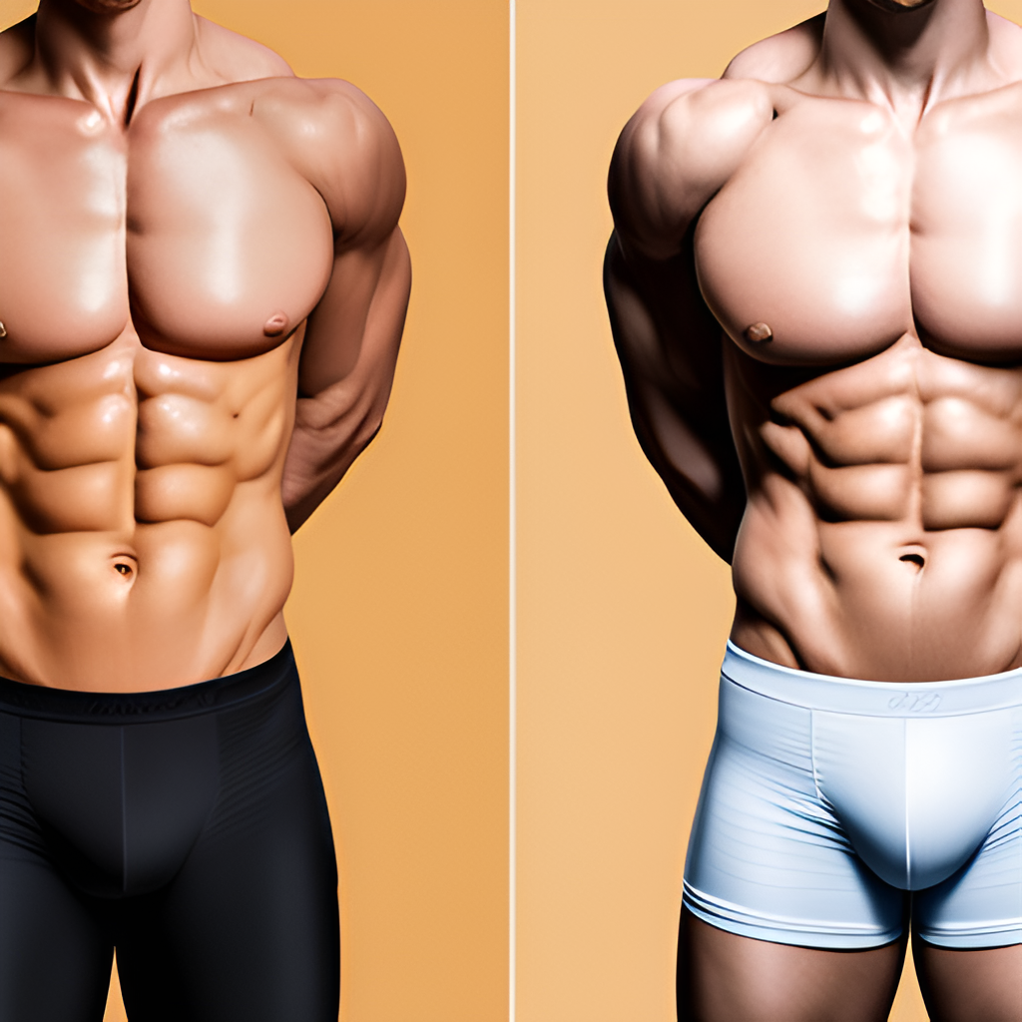
Why is body fat important?
Body fat is often viewed as something negative, but it actually plays an important role in our overall health.
It serves several important functions in the body.
PICTURE

Slide 5
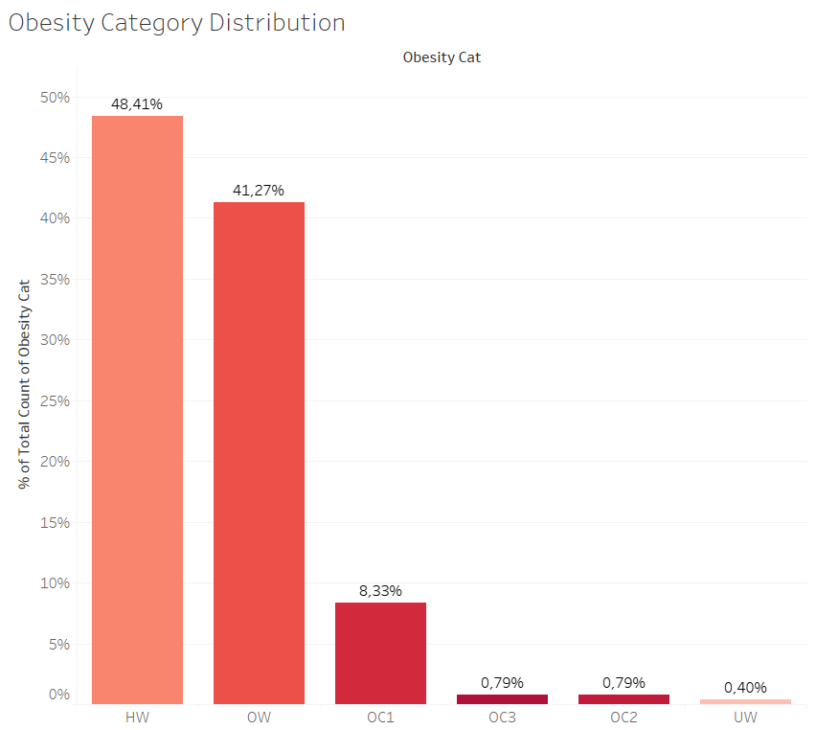
BMI category distribution
After analyzing our data and according to individuals Body Mass Index (BMI);
Under Weight - 0,40% (BMI: 0 - 18.5)
Healthy Weight - 48.41% (BMI: 18.5 - 25)
Overweight - 41.27% (BMI: 25 - 30)
Obese - 9.91% (BMI: > 30)

Slide 6
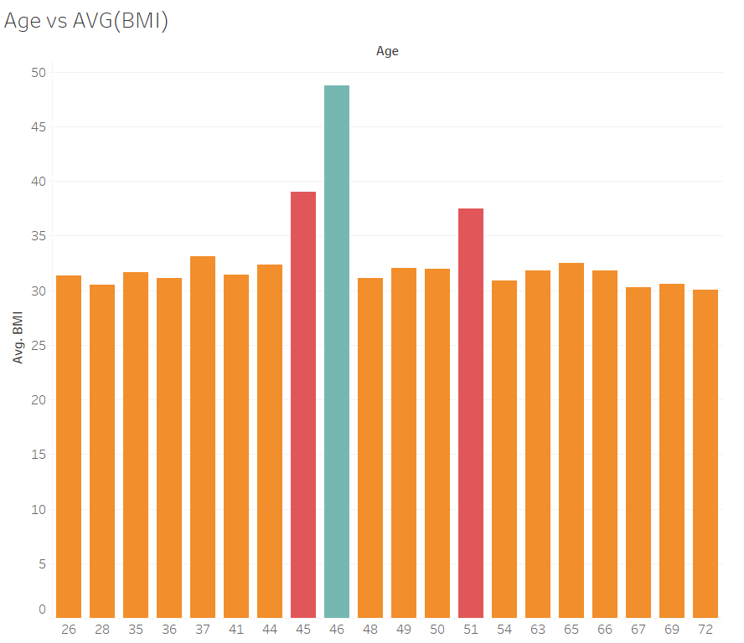
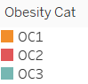
BMI category distribution (age)
Obesity is more common after the age of 35.
Obesity Categories :
Cat 1 (BMI: 30 – 35)
Cat 2 (BMI: 35 – 40)
Cat 3 (BMI: > 40)

Slide 7
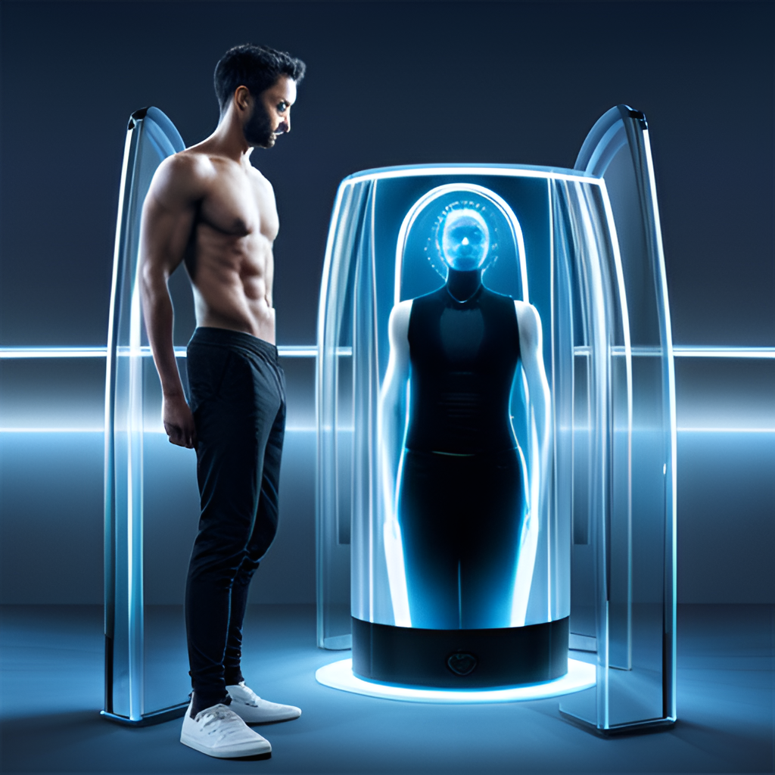
The Problem
Accurately measuring the body fat percentage.
Current methods can be affected by various factors such as hydration levels, time of day, and even the person administering the test.

Slide 8
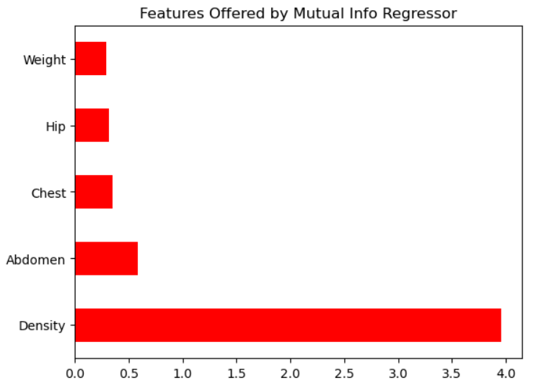
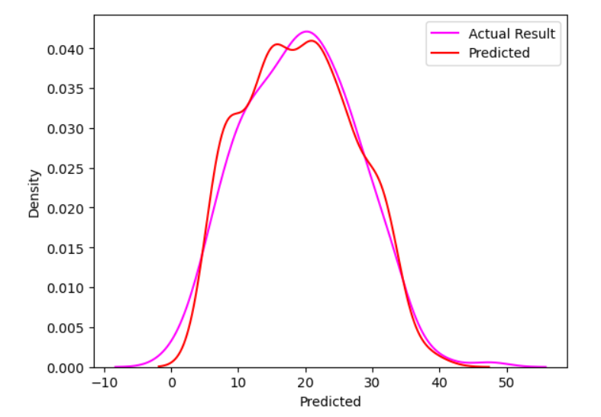
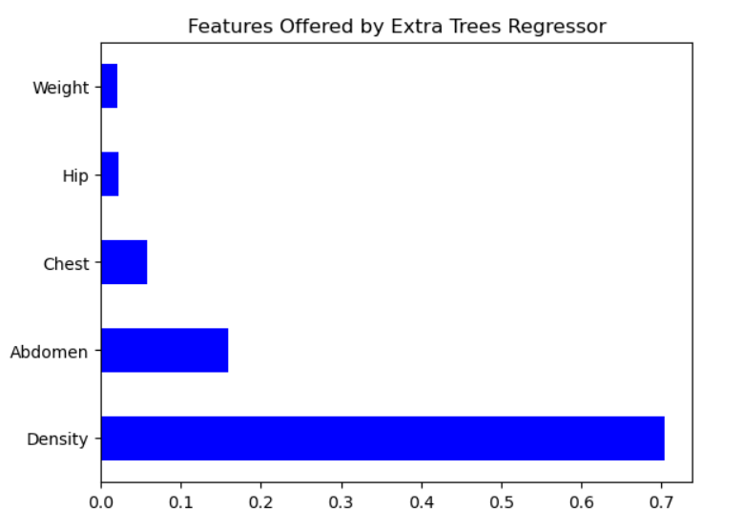
The Solution
The solution is our revolutionary
Fit & Hot Body Fat Estimator App.

Slide 9
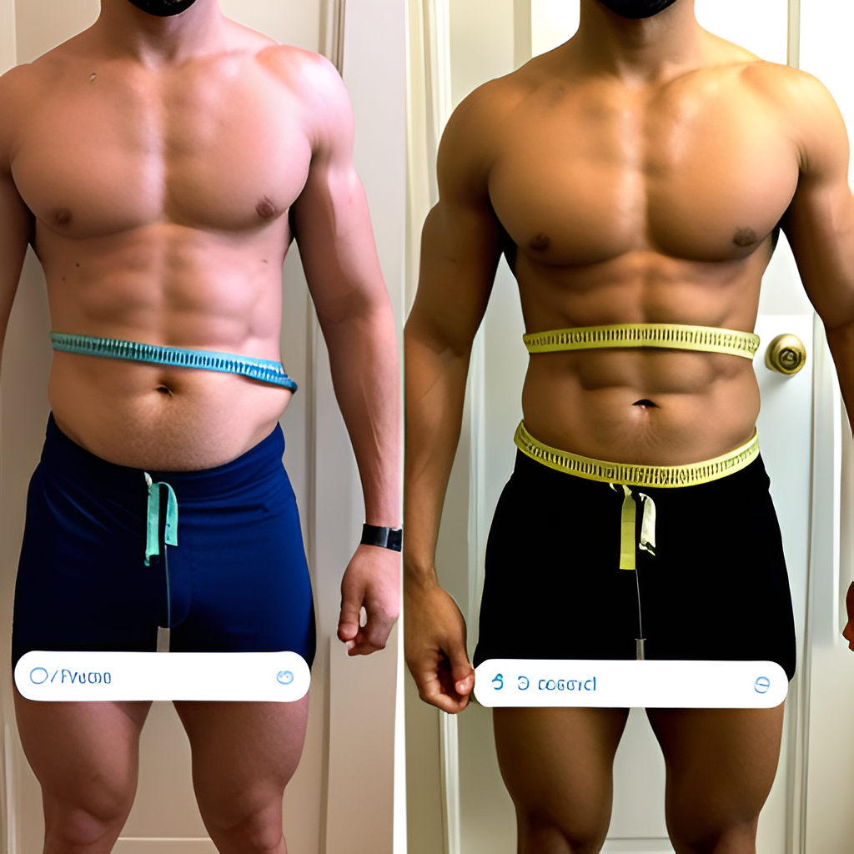
Your own body measurements.
You all know how to measure the hip , chest and abdomen circumference.

Slide 10
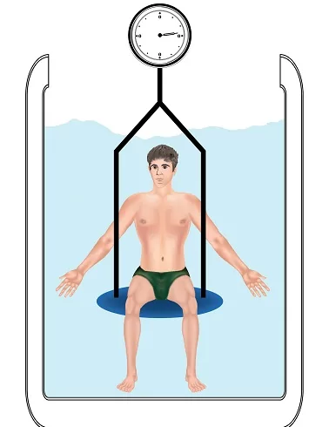
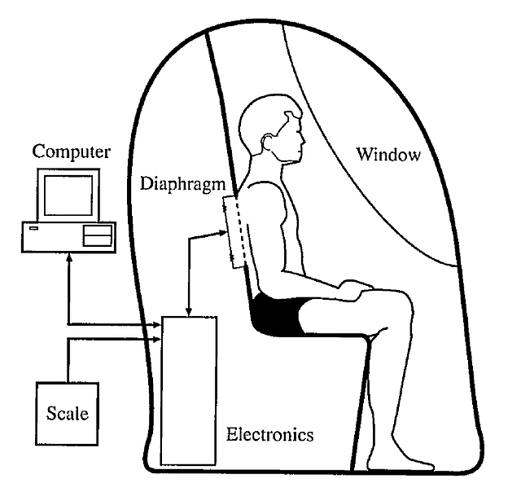
More Measurements . . .
Do you know how to find your body density ?
1. Hydrostatic weighing
2. Whole-Body Air-Displacement Plethysmography

Slide 11
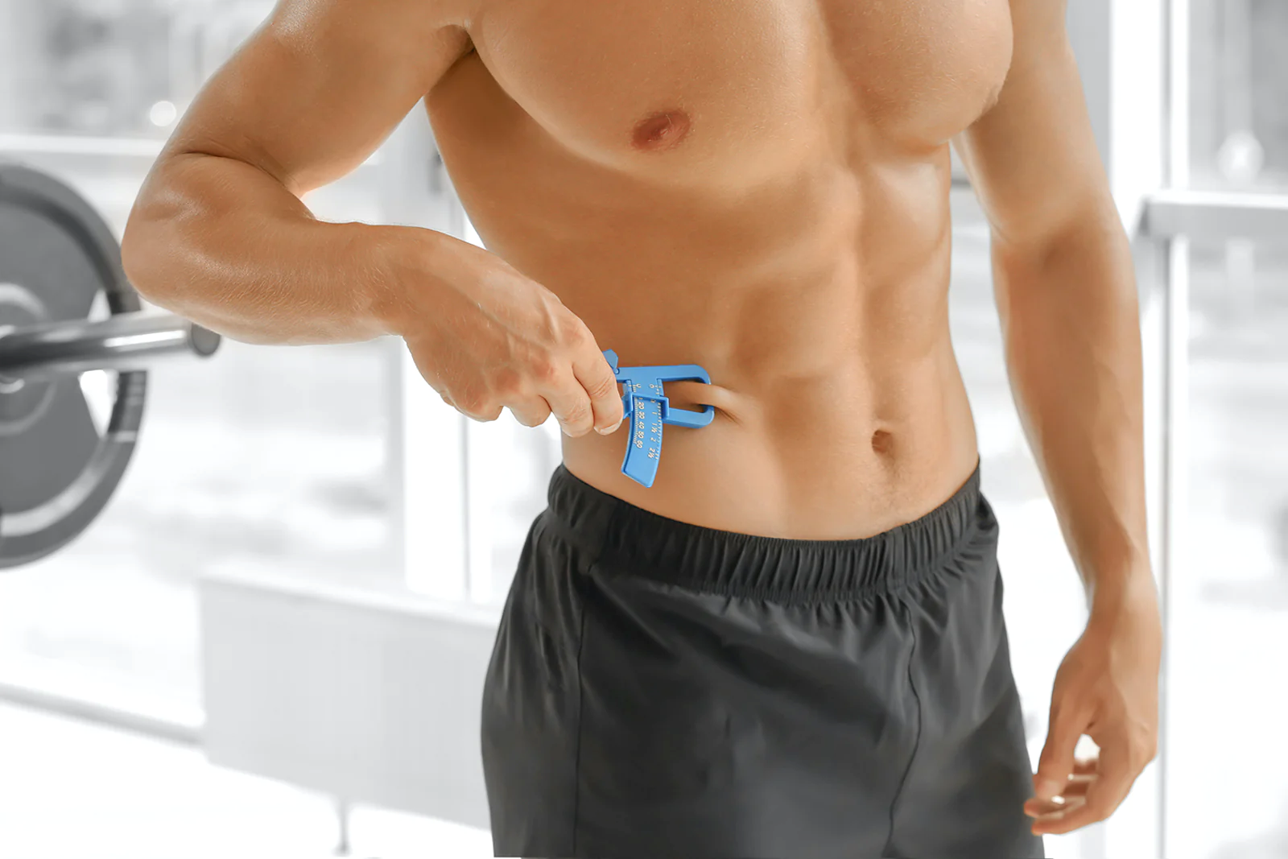
More Measurements . . .
How to calculate your body density using skinfold caliper ?
Some of the skinfold measurement locations include:
Tricep
Bicep
Subscapular
Suprailiac
﻿
It takes around 10 minutes to find your body density with a skinfold caliper.

Slide 12
How does it works?
Lets Go to Fit & Hot

Slide 13
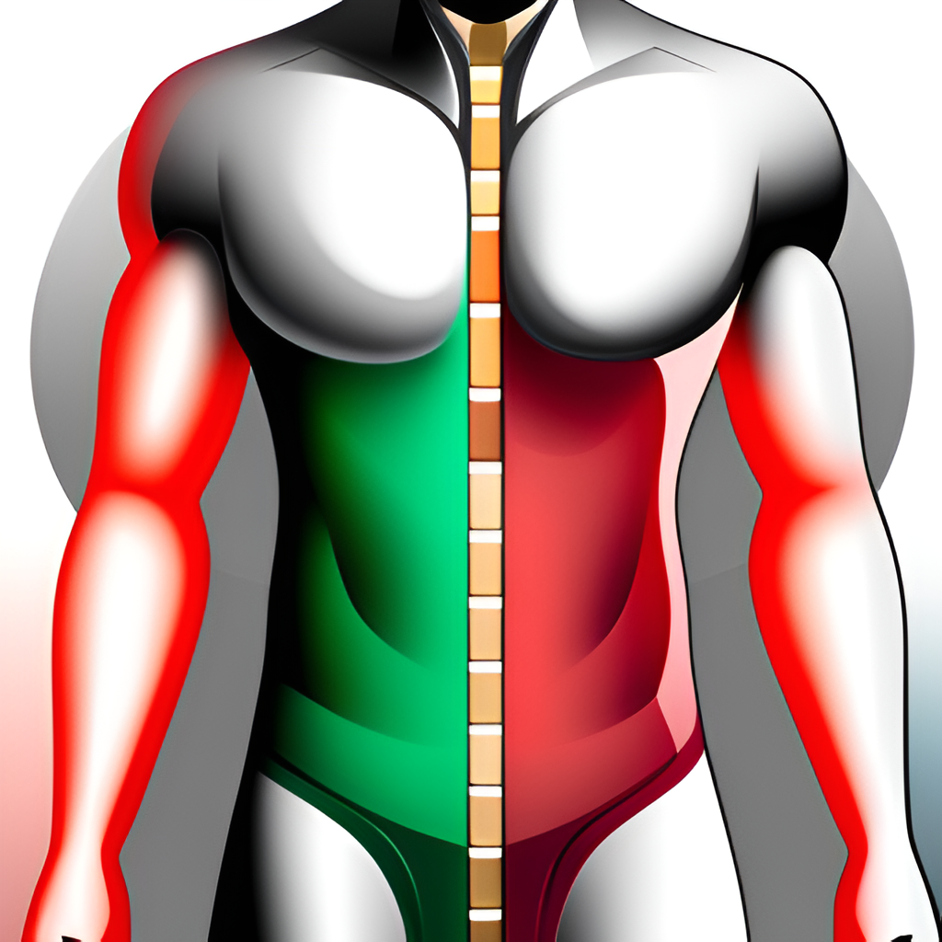
Benefits
Convenience
Accuracy

Slide 14
Future Scope and Conclusion
With the help of machine learning , we can now provide a more accurate and convenient solution.
Adding more data.
Adding body density calculator to the APP.

Slide 15
Stay FIT & HOT!

